Slide 1
Trees

Slide 2
Definition of Tree
A tree is a finite set of one or more nodes such that:
There is a specially designated node called the root.
The remaining nodes are partitioned into n>=0 disjoint sets T1, ..., Tn, where each of these sets is a tree.
We call T1, ..., Tn the subtrees of the root.

Slide 3
Applications
Auto complete features (Trie)
For easier substring matching
For metadata indexing in file systems (B+ tree)
To maintain table indices in relational database systems (B+ tree)
Store dictionary in a mobile (Trie)
To check spellings (Trie)
To construct associative array (Red black trees)
To ensure direct access of data blocks in file systems (B tree)
Used by compilers to check the syntax of a statement in a program (Parse Trees)
Used by operating systems to maintain the structure of a file system
Huffman coding for data compression

Slide 4
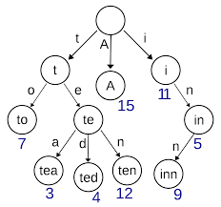
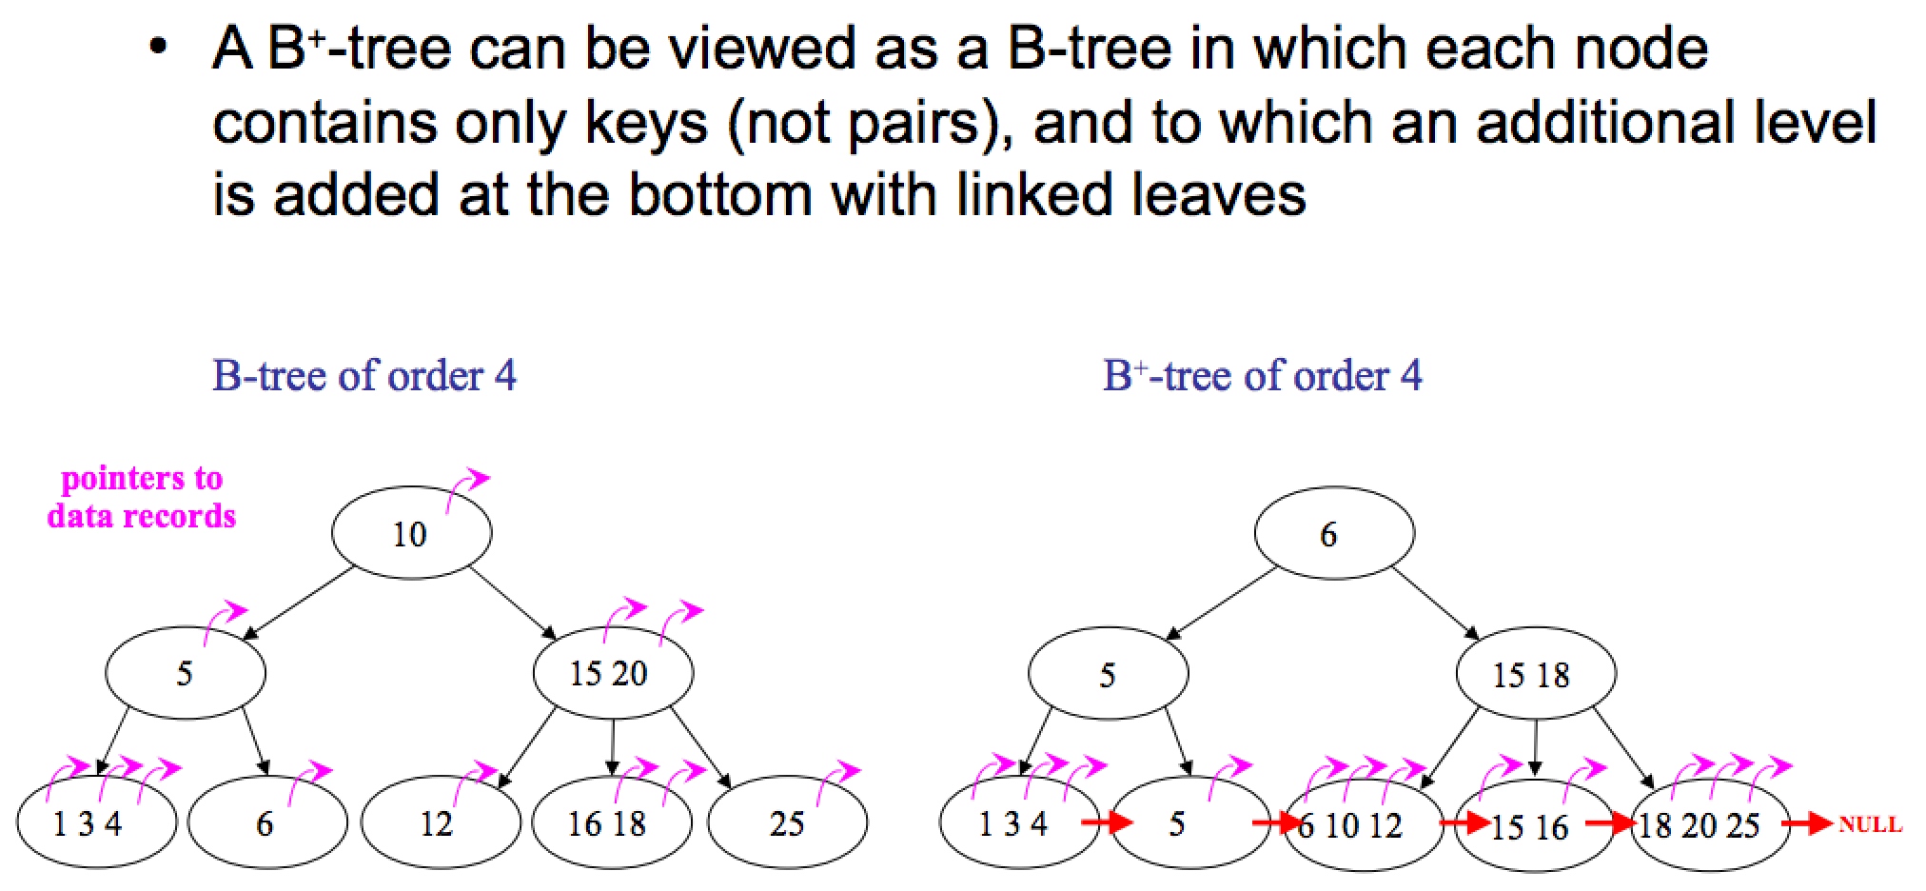
Trie, B trees, B+ trees

Slide 5
Level and Depth
Node (13)
Degree of a node
Leaf (terminal)
Nonterminal
Parent
Children
Sibling
Degree of a tree (3)
Ancestor
Level of a node
Height of a tree (4)
Level
1
2
3
4
Degree
Level
3
1
2
2
1
2
3
2
2
3
0
3
0
3
1
3
0
3
0
3
0
0
4
0
4
4

Slide 6
Terminology
The degree of a node is the number of subtrees of the node
The degree of A is 3; the degree of C is 1.
The node with degree 0 is a leaf or terminal node.
A node that has subtrees is the parent of the roots of the subtrees.
The roots of these subtrees are the children of the node.
Children of the same parent are siblings.
The ancestors of a node are all the nodes along the path from the root to the node.

Slide 7
Representation of Trees
List Representation
( A ( B ( E ( K, L ), F ), C ( G ), D ( H ( M ), I, J ) ) )
The root comes first, followed by a list of sub-trees
data
link 1
link 2
...
link n
How many link fields are
needed in such a representation?

Slide 8
Left Child - Right Sibling
data
A
left child
right sibling
B
C
D
E
F
G
H
I
J
K
L
M
Fig 1

Slide 9
Binary Trees
A binary tree is a finite set of nodes that is either empty or consists of a root and two disjoint binary trees called the left subtree and the right subtree.
Any tree can be transformed into binary tree.
by left child-right sibling representation
The left subtree and the right subtree are distinguished.

Slide 10
Left child-right child tree representation of a tree (fig1)
A
B
E
C
G
D
K
F
H
L
M
I
J

Slide 11
Abstract Data Type Binary_Tree
ADT Binary_Tree(abbreviated BinTree) is
objects: a finite set of nodes either empty or consisting of a root node, left Binary_Tree, and right Binary_Tree.
functions:
for all bt, bt1, bt2 ∈ BinTree, item ∈ element
Bintree Create()::= creates an empty binary tree
Boolean IsEmpty(bt)::= if (bt==empty binary tree) return TRUE else return FALSE

Slide 12
BinTree MakeBT(bt1, item, bt2)::= return a binary tree
whose left subtree is bt1, whose right subtree is bt2,
and whose root node contains the data item
Bintree Lchild(bt)::= if (IsEmpty(bt)) return error else return the left subtree of bt
element Data(bt)::= if (IsEmpty(bt)) return error else return the data in the root node of bt
Bintree Rchild(bt)::= if (IsEmpty(bt)) return error else return the right subtree of bt

Slide 13
Samples of Trees
Skewed Binary Tree
Complete Binary Tree
1
A
A
2
B
B
C
3
C
D
E
F
G
4
D
H
I
5
E

Slide 14
Maximum Number of Nodes in BT
The maximum number of nodes on level i of a binary tree is 2^{i-1}, i>=1.
The maximum nubmer of nodes in a binary tree of depth k is 2^{k}-1, k>=1.

Slide 15
Full BT VS Complete BT
A full binary tree of depth k is a binary tree of depth k having 2 -1 nodes, k>=0.
A binary tree with n nodes and depth k is complete iff its nodes correspond to the nodes numbered from 1 to n in the full binary tree of depth k.
k
1
1
2
3
2
3
4
5
6
7
4
5
6
7
8
9
8
9
10
11
12
13
14
15
Complete binary tree
Full binary tree of depth 4

Slide 16
Binary Tree Representations
If a complete binary tree with n nodes is represented sequentially, then for any node with index i, 1<=i<=n, we have:
parent(i) is at i/2 if i!=1. If i=1, i is at the root and has no parent.
left_child(i) ia at 2i if 2i<=n. If 2i>n, then i has no left child.
right_child(i) ia at 2i+1 if 2i +1 <=n. If 2i +1 >n, then i has no right child.

Slide 17
Sequential Representation
[1]
[2]
[3]
[4]
[5]
[6]
[7]
[8]
[9]
A
B
C
D
E
F
G
H
I
(1) waste space
(2) insertion/deletion
problem
[1]
[2]
[3]
[4]
[5]
[6]
[7]
[8]
[9]
.
[16]
A
B
--
C
--
--
--
D
--
.
E
A
B
A
C
B
C
D
D
E
F
G
E
H
I

Slide 18
Linked Representation
struct node {
int ele;
struct node *lchild, *rchild;
};
data
left_child
data
right_child
left_child
right_child

Slide 19
Binary Tree Traversals
inorder, postorder, preorder
1,5,7,6,8,3,2,4-preorder
7,5,1,3,8,2,6,4 -inorder

Slide 20
Preorder Traversal
Preorder order traversal of a binary tree can be recursively defined as follows:
Process the root node
Traverse the left subtree in preorder
3. Traverse the right subtree in preorder

Slide 21
Inorder Traversal
Inorder order traversal of a binary tree can be recursively defined as follows:
1. Traverse the left subtree in inorder
Process the root node
3. Traverse the right subtree in inorder

Slide 22
Postorder Traversal
Postorder order traversal of a binary tree can be recursively defined as follows:
1. Traverse the left subtree in postorder
2. Traverse the right subtree in postorder
Process the root node

Slide 23
Arithmetic Expression Using BT
+
inorder traversal
A / B * C * D + E
infix expression
preorder traversal
+ * * / A B C D E
prefix expression
postorder traversal
A B / C * D * E +
postfix expression
level order traversal
+ * E * D / C A B
*
E
*
D
/
C
A
B

Slide 24
Inorder Traversal (recursive version)
void inorder(struct node * ptr)
/* inorder tree traversal */
{
if (ptr!=NULL) {
inorder(ptr->lchild);
printf(“%d”, ptr->ele);
inorder(ptr->rchild);
}
return;
}
A / B * C * D + E

Slide 25
Trace Operations of Inorder Traversal

Slide 26
Preorder Traversal (recursive version)
void preorder(struct node * ptr)
/* preorder tree traversal */
{
if (ptr!=NULL) {
printf(“%d”, ptr->ele);
preorder(ptr->lchild);
preorder(ptr->rchild);
}
}
+ * * / A B C D E

Slide 27
Postorder Traversal (recursive version)
void postorder(struct node * ptr)
/* postorder tree traversal */
{
if (ptr!=NULL) {
postorder(ptr->lchild);
postorder(ptr->rchild);
printf(“%d”, ptr->ele);
}
}
A B / C * D * E +

Slide 28
Iterative Inorder Traversal (using stack)
void iter_inorder(struct node *ptr)
{
int top= -1; /* initialize stack */
struct node *stack[MAX_STACK_SIZE];
for (;;) {
for (; ptr!=NULL; ptr=ptr->lchild)
push(ptr);/* add to stack */
ptr=pop();
/* delete from stack */
if (ptr==NULL) break; /* empty stack */
printf(“%d”, ptr->ele);
ptr= ptr->rchild;
}
}

